Slide 1

PROJEC TITLE: BIGBASKET SPRINT-1
Team:3
Team Members:
1.Bhargavi
2.Kalyani
3.Prajyothi
4.Indu Priya
5.Jayasri

Slide 2

Project Description
Big Basket is one of the largest online grocery super market in India. It was founded in 2011 by Hari Menon, VS Sudhakar, V S Ramesh, Vipul Parekh and Abhinay choudari. It has its headquarters in Bengaluru. It operates in more than 30 cities in India. Big basket offers variety of products ranging from fresh fruits, vegetables, Food grains, oil, masala, packaged snacks, beverages, household supplies, healthcare products. It has more than 20000 products and 1000 brands in its catalogue.
Big Basket caters to the demands of the fast-paced world where time is a precious commodity. It has made grocery shopping easy and convenient by making daily essentials shopping a breeze. Customers can shop for Fresh Fruits and Vegetables, Pulses, Condiments, Beverages and Processed foods and even personal care items and meats. Delivering grocery and other items to households in more than 25 cities across India

Slide 3
Modules that are tested:
Verifying
Verifying Registration functionality
Verifying
Verifying Login functionality
Verifying
Verifying search functionality
Verifying
Verifying Add to My Basket functionality
Verifying
Verifying Address functionality

Slide 4
Testers Role
Each member in the team took one module for testing.
We created Epics, User Stories, Requirements, Test Scenarios, Test cases, Defect reports, Traceability matrix and Test summary report for each module.
We have checked all the maximum test cases possible and verified them whether test cases working or not.
We have Worked in jira as well.

Slide 5
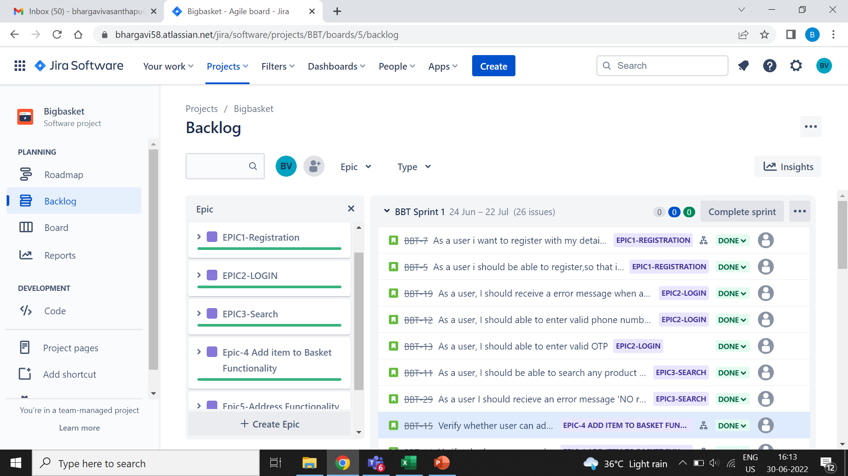
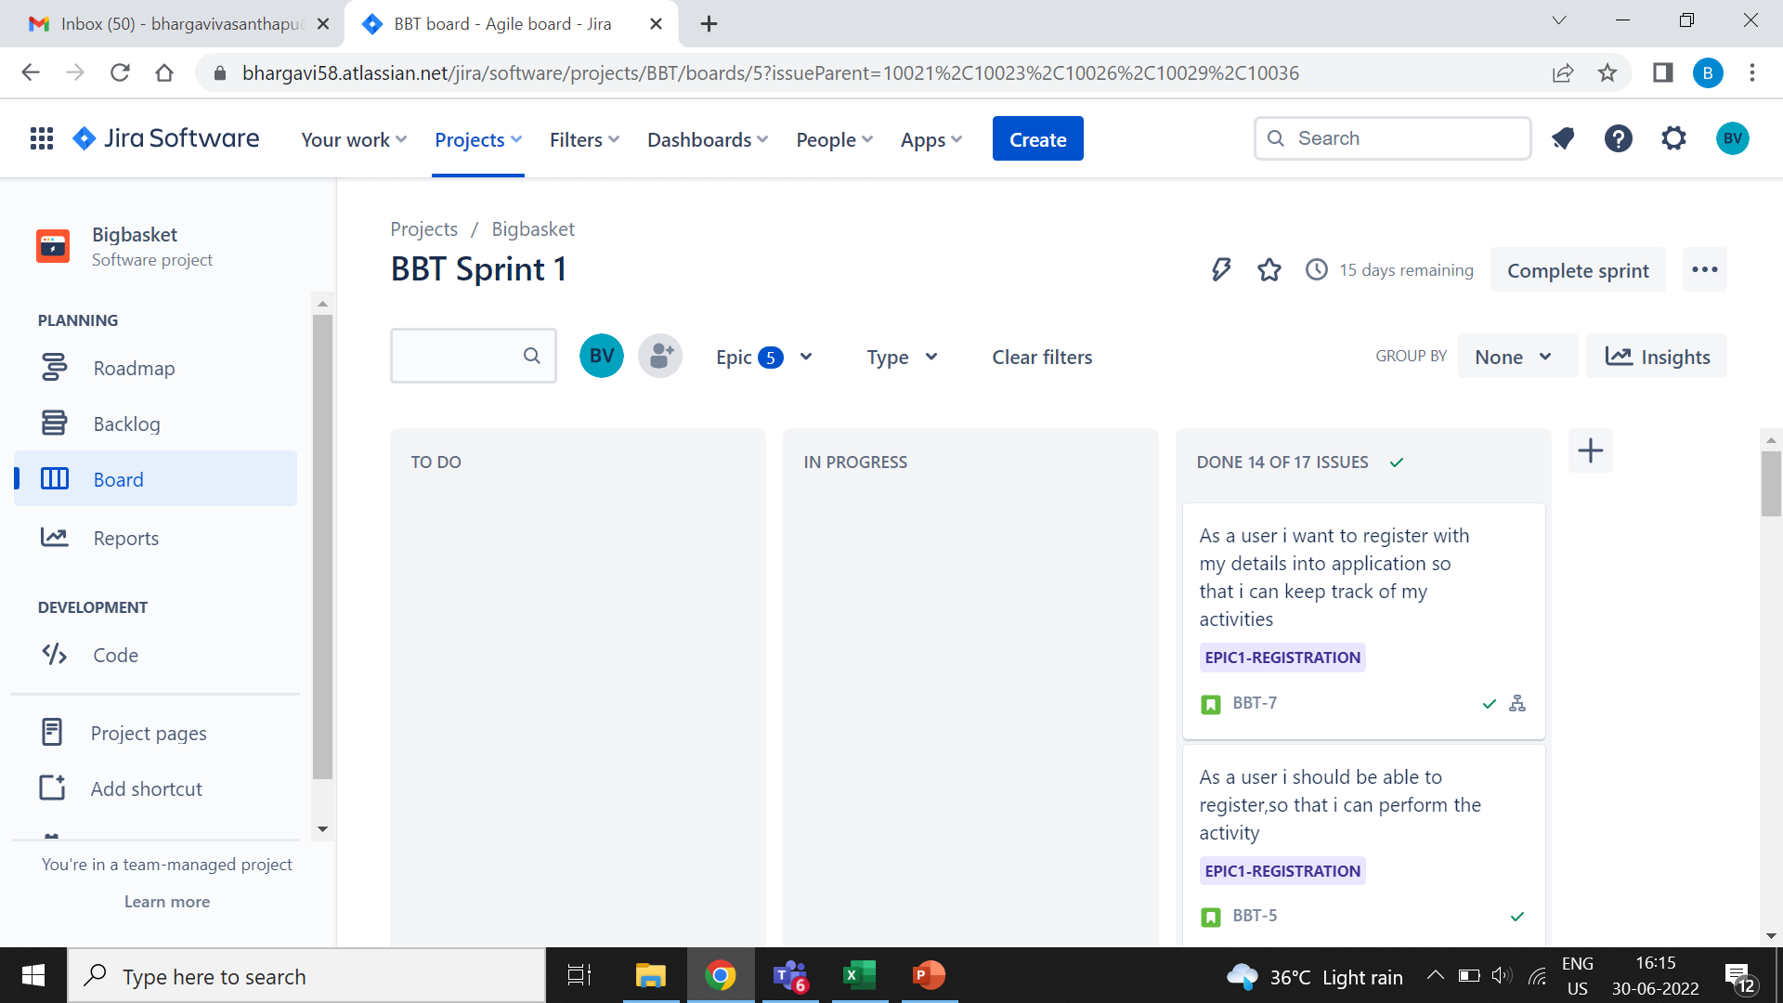
Process of Testing and Sprint plan
At first Epics and user stories are written
User stories are added in jira accordingly
Epic issues are processed to TO DO, IN PROGRESS and DONE
And the we have started Sprint.

Slide 6
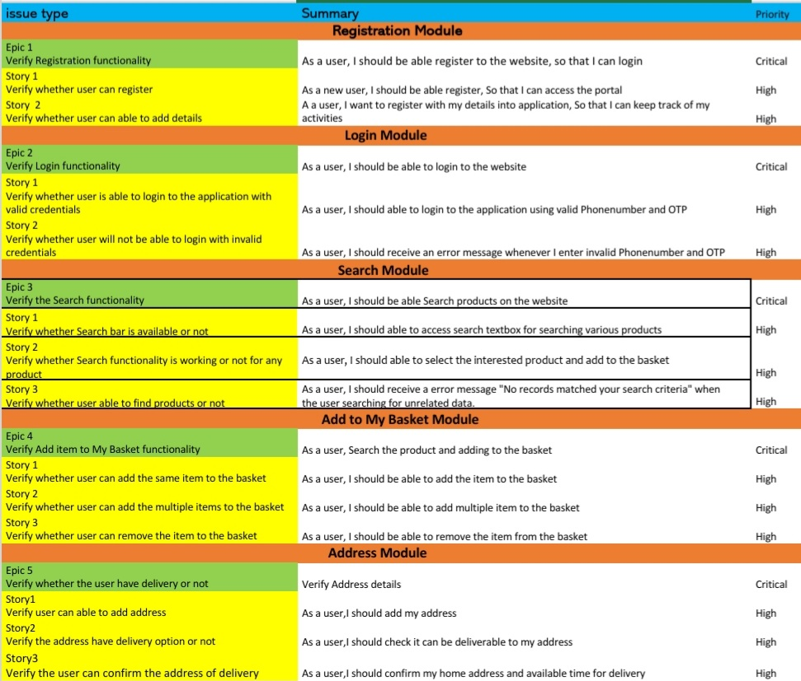
High Level Epic and user stories
Epics are a helpful way to organize your work and to create a hierarchy. The idea is to break work down into shippable pieces so that large projects can actually get done and you can continue to ship value to your customers on a regular basis. Epics help teams break their work down, while continuing to work towards a bigger goal.
The purpose of a user story is to articulate how a piece of work will deliver a particular value back to the customer. Note that "customers" don't have to be external end users in the traditional sense, they can also be internal customers or colleagues within your organization who depend on your team.

Slide 7
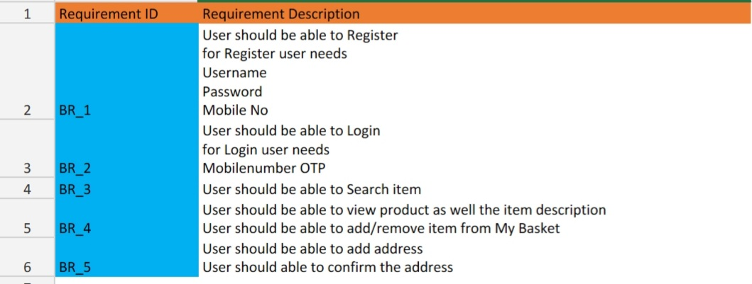
Requirements

Slide 8
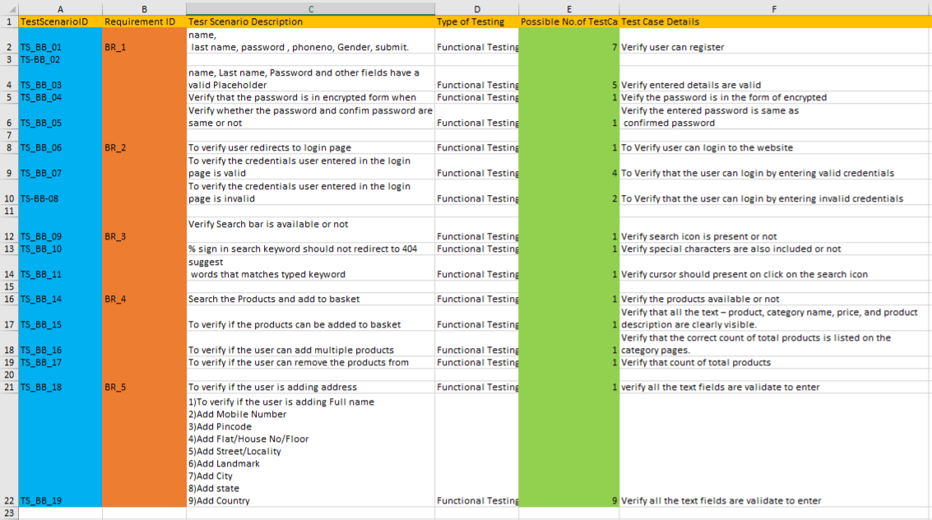
Test Scenarios
A Test Scenario is defined as any functionality that can be tested. It is also called Test Condition or Test Possibility. As a tester, you should put yourself in the end user’s shoes and figure out the real-world scenarios and use cases of the Application Under Test.

Slide 9
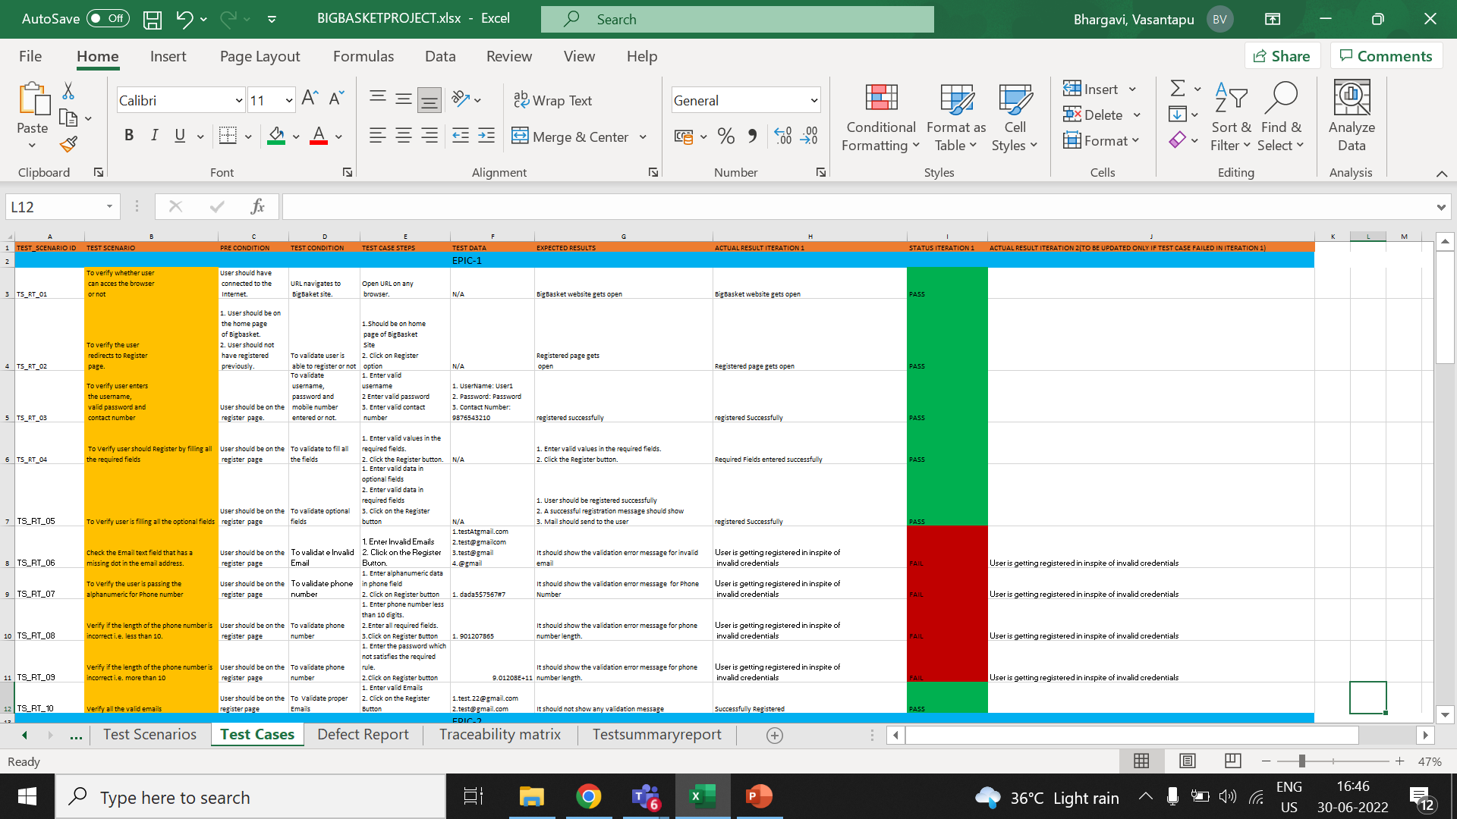
Test cases:
A test case has components that describe input, action, and an expected response, in order to determine if a feature of an application works correctly.
A test case is a set of instructions on “HOW” to validate a particular test objective/target, which, when followed will tell us if the expected behavior of the system is satisfied or not.

Slide 10
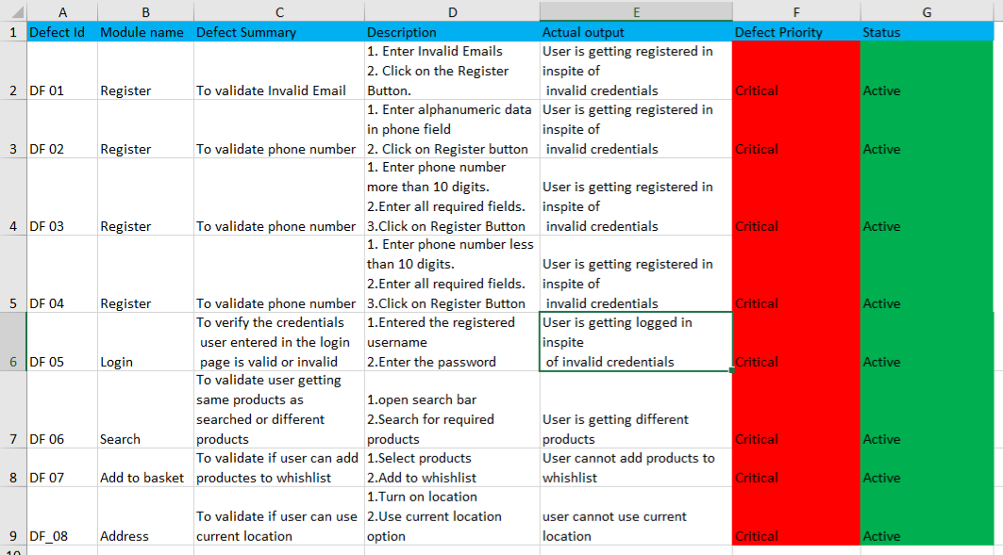
Defect report: DEFECT REPORT, also known as Bug Report, is a document that identifies and describes a defect detected by a tester. The purpose of a defect report is to state the problem as clearly as possible so that developers can replicate the defect easily and fix it.

Slide 11
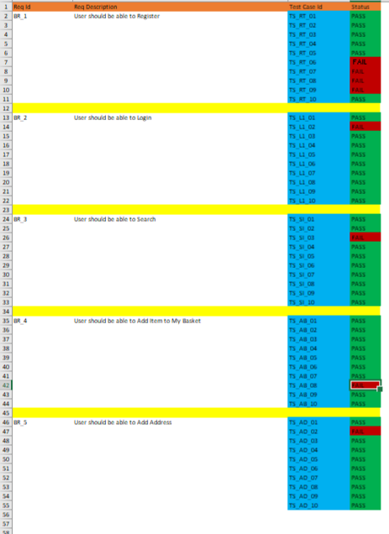
Traceability matrix:
Traceability matrix is a table type document that is used in the development of software application to trace requirements. It can be used for both forward and backward tracing.

Slide 12
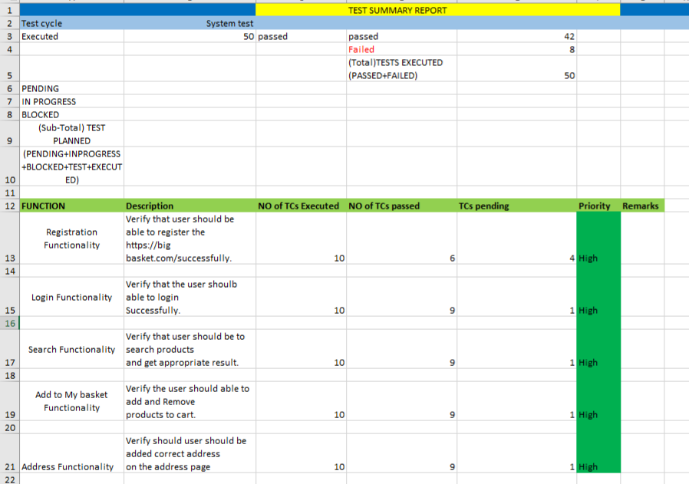
Summary report

Slide 13
Challenges faced
Working in a team is actually a challenge in virtual mode.
As each individual is working separately we have to combine together all the work that is done
In Big Basket application there are no difficult challenges Faced by us as this is a real application.
Working in jira is challenging as we haven’t worked before and testing bugs is difficult.
We have learned how to work in a team and overcame the difficulties and saved time.

Slide 14

THANKYOU

